Slide 1
Machine Learning Observability
Pravin Y Pawar
Adapted from “Machine Learning Observability”

Slide 2
What is ML Observability?
ML Observability is a tool used to monitor, troubleshoot, and explain machine learning models
as they move from research to production environments
An effective observability tool should not only automatically surface issues,
but drill down to the root cause of your ML problems and act as a guardrail for models in production

Slide 3
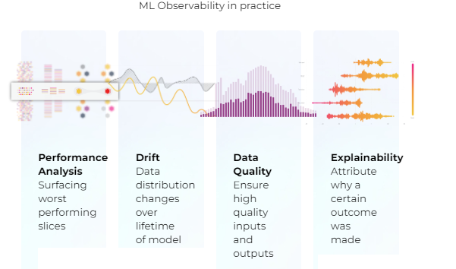
4 Pillars of ML Observability

Slide 4
Performance Analysis
ML observability enables fast actionable performance information on models deployed in production
While performance analysis techniques vary on a case-by-case basis depending on model type and its use case in the real world,
common metrics include: Accuracy, Recall, F-1, MAE, RMSE, and Precision
Performance analysis in an ML observability system ensures that performance has not degraded drastically from when it was trained or when it was initially promoted to production.

Slide 5
Drift
ML observability encompasses drift to monitor for a change in distribution over time,
measured for model inputs, outputs, and actuals of a model
Measure drift to identify if models have grown stale, have data quality issues, or if there are adversarial inputs in model
Detecting drift in models will help protect models from performance degradation and allow to better understand how to begin resolution

Slide 6
Data Quality
Data quality checks in an ML observability system identify hard failures
within data pipelines between training and production
that can negatively impact a model’s end performance
Data quality includes
monitoring for cardinality shifts,
missing data,
data type mismatch,
out-of-range,
and more to better gauge model performance issues and ease RCA

Slide 7
Explainability
Explainability in ML observability uncovers feature importance
across training, validation, and production environments
which provides the ability to introspect and understand why a model made a particular prediction
Explainability is commonly achieved by
calculating metrics such as SHAP and LIME
to build confidence and continuously improve machine-learned models

Slide 8
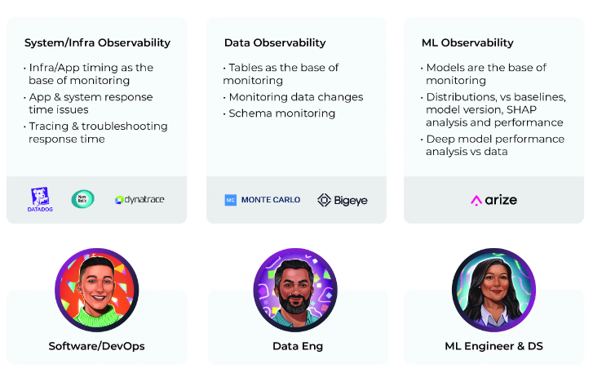
ML observability in context
arize

Slide 9
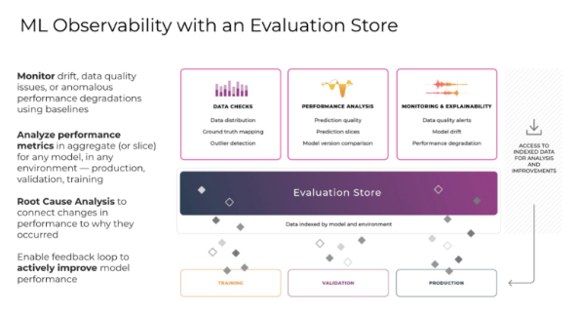
How Can I Achieve ML Observability?
arize

Slide 10
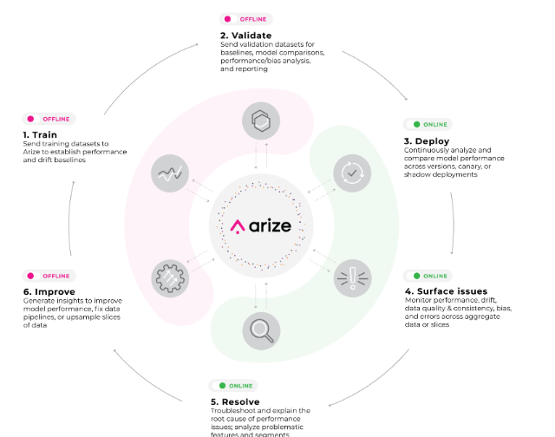
ML Observability with Arize
ML Observability is the practice of obtaining a deep understanding into model’s data and performance across its lifecycle
Observability doesn't just stop at surfacing a red or green light,
but enables ML practitioners to root cause/explain why a model is behaving a certain way in order to improve it

Slide 11
Thank You!
In our next session:

